Slide 1

IIITG Express: Lost & Found Project
Welcome to our presentation on the IITG Express Lost & Found Project. This project aims to address the common issue of lost and found items within the IITG campus, creating a user-friendly and efficient system to connect lost items with their rightful owners. Our goal is to reduce frustration and provide a more convenient solution for all students and faculty.

Slide 2
Problem Statement: The Need for an Efficient System
Current Challenges
User Frustration
Email Overload
The existing system for lost and found items within the IITG campus is often inefficient and cumbersome. Misplaced items are frequently lost for good due to lack of proper organization, identification, and communication.
Losing valuable items can be stressful and time-consuming. The current system often leaves students and faculty feeling frustrated and discouraged in their efforts to recover their lost belongings.
The current system relies heavily on emails for lost and found notifications, leading to inbox clutter. Important messages often get buried, making it difficult for users to track updates on their lost items efficiently.

Slide 3

Project Goals and Objectives
1
Create a Centralized Database
2
Enhance Communication
Develop a secure and comprehensive database to store information about lost and found items, including detailed descriptions, timestamps, and locations.
Implement a user-friendly interface that allows users to easily report lost items, search for found items, and communicate directly with the Lost & Found team.
3
Improve Efficiency
Streamline the process of claiming lost items, reducing the time and effort required for both users and the Lost & Found team.

Slide 4




System Architecture Overview
User Interface
Backend Database
Notification System
A web-based interface for students and faculty to report lost items, search for found items, and receive updates.
A robust database to store information about lost and found items, including detailed descriptions, timestamps, and locations.
A notification system to alert users about relevant updates, such as matching found items, or when their lost item is claimed.

Slide 5



Backend Structure and Code Snippets
Database Design
API Endpoints
Security Measures
RESTful APIs are designed to handle requests from the user interface, allowing for seamless data transfer between the frontend and backend.
The backend utilizes a relational database, structured with tables for lost items, found items, users, and other relevant information.
Robust security measures are implemented to protect user data and prevent unauthorized access to the database.

Slide 6
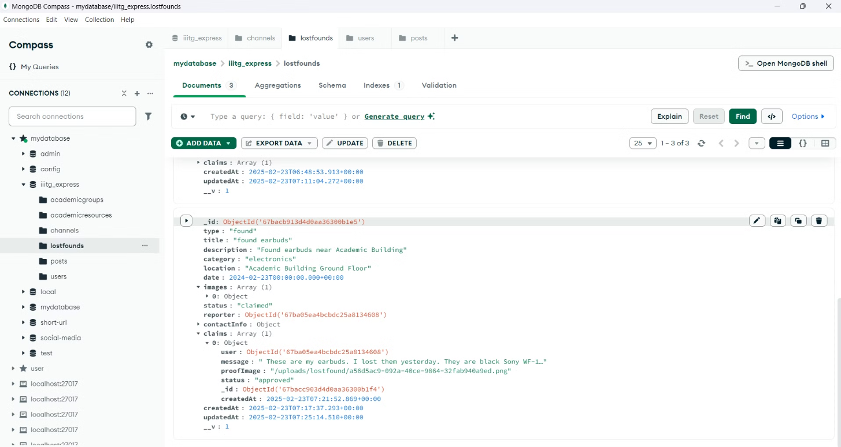
Database: object example

Slide 7
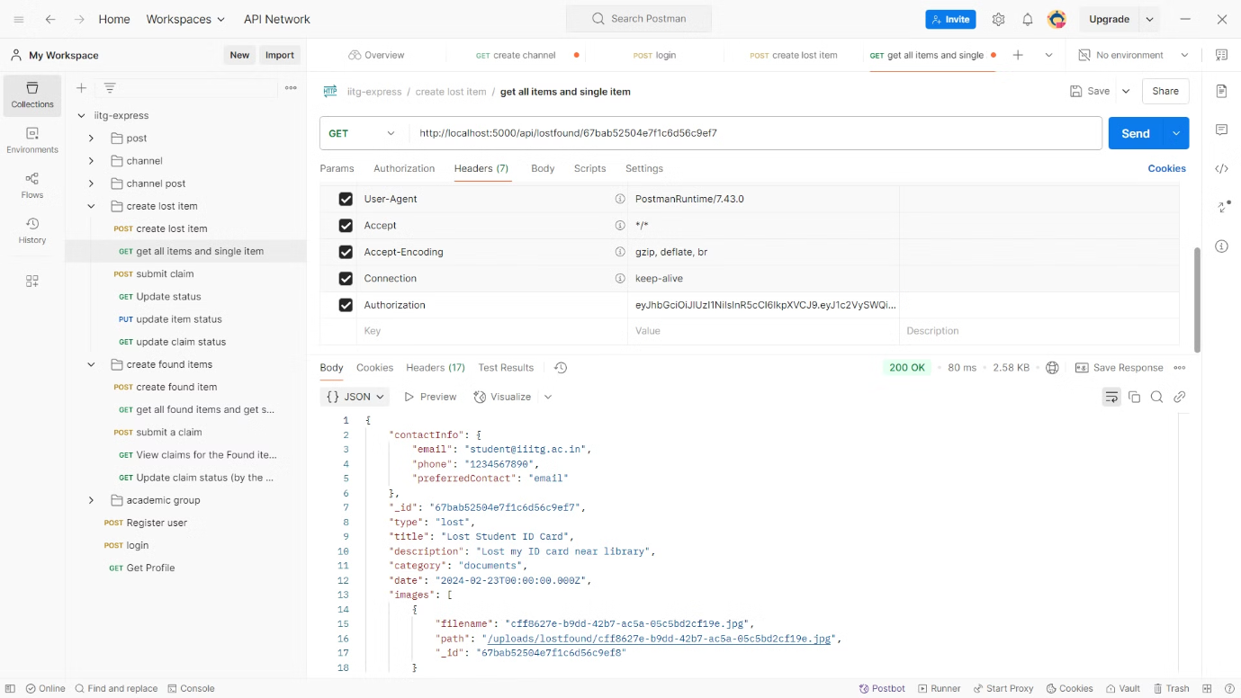
Restful API

Slide 8
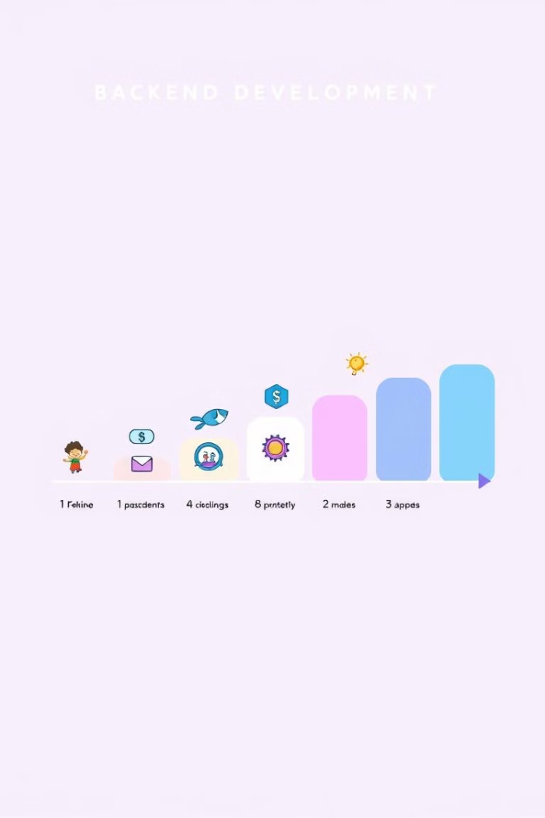
Current Progress & Milestones Achieved: Backend Ready
1
Database Design and Implementation
The backend database has been successfully designed and implemented, ensuring efficient storage and retrieval of data related to lost and found items.
2
API Development
All necessary RESTful APIs have been developed to handle data requests from the user interface and ensure smooth communication between the frontend and backend.
3
Security Measures Implementation
Security features, including user authentication, data encryption, and access control, have been integrated into the backend system.

Slide 9
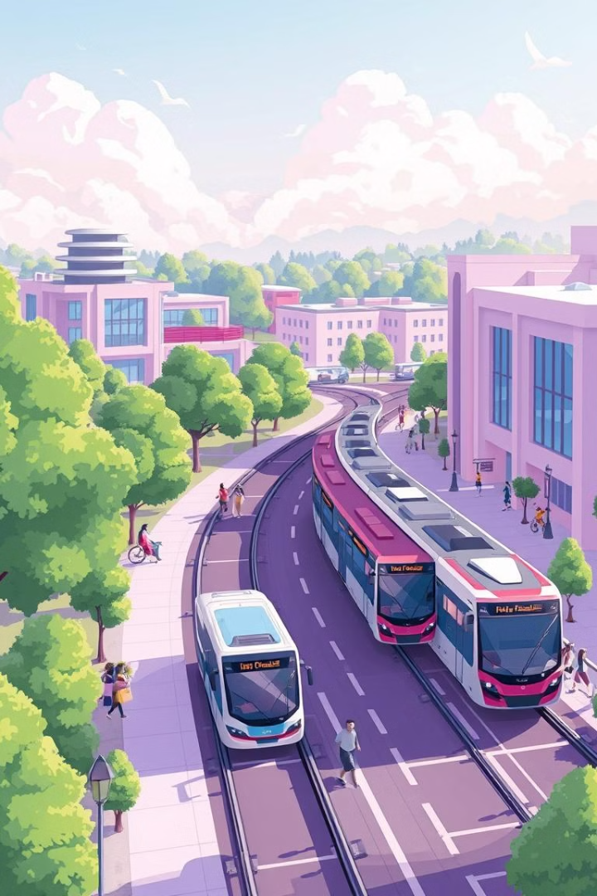



Future Aspects and Scalability
Mobile App Development
Developing a dedicated mobile application for IITG Express will provide users with enhanced accessibility and convenience, allowing them to report lost items and search for found items directly from their smartphones.
Integration with Campus Systems
Integrating IITG Express with existing campus systems, such as the student information system or the security system, will streamline data sharing and enable automated notifications for lost items.
Advanced Search Features
Implementing advanced search filters, such as item type, location, and time range, will empower users to quickly and accurately locate lost and found items.

Slide 10

Q&A and Next Steps
We are excited to answer any questions you may have about the IIITG Express project. Our team is dedicated to creating a valuable and user-friendly solution for the IIITG community. The next steps include finalizing the frontend development, conducting thorough testing, and launching the project to students and faculty. Created By: Ashutosh kumar (2201040)

